Slide 1
Gradient Based Optimization via Dynamic Message Passing
---Influence Maximization over IC model
Fei Gao. 2019/11/27

Slide 2
Contents
Influence maximization problem (IMP).
Dynamic Message Passing (DMP) for SIR (IC) model.
IMP as a Continuous Optimization Problem.
Experiments (vs IMM).
Analytic Results:
How gradient works.
How penalty works.
Bad case study.

Slide 3
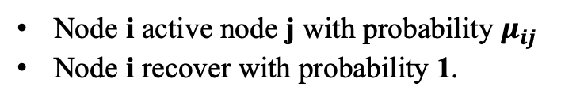

1. Influence maximization problem (IMP).
Given a stochastic spreading model on graph, IMP aims to find a set of initial nodes S with fixed size K, such that the final expected spreading range is maximized.
Here, we focus on a stochastic spreading model named Independent Cascade Model ( IC ), which is a special case of discrete SIR model.
R
i
Node i active node j with probability $μ_{ij}$
Node i recover with probability 1.
I
$$μ_{ij}$$
j
S

Slide 4
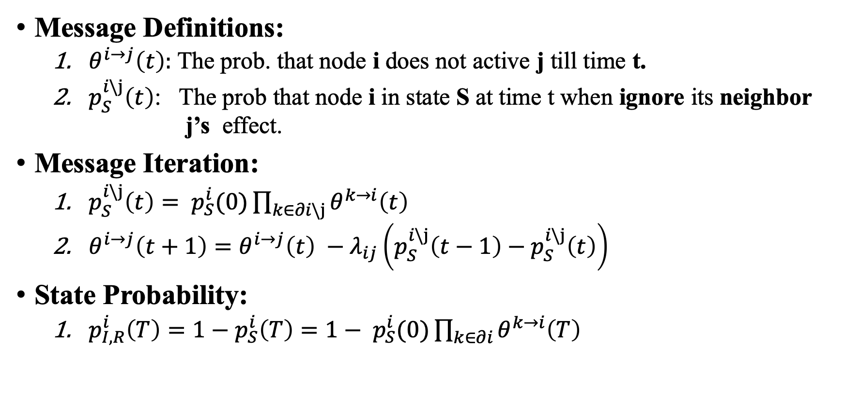
2. DMP for SIR (IC)
Message Definitions:
$θ^{i→j}\left(t\right):$ The prob. that node i does not active j till time t.
$p_{S}^{i\backslash j}\left(t\right)$: The prob that node i in state S at time t when ignore its neighbor j’s effect.
Message Iteration:
$p_{S}^{i\backslash j}\left(t\right)= p_{S}^{i}(0)\prod_{k∈∂i\backslash j}{θ^{k→i}\left(t\right)}$
$θ^{i→j}\left(t+1\right)=θ^{i→j}\left(t\right) −λ_{ij}\left(p_{S}^{i\backslash j}\left(t−1\right)−p_{S}^{i\backslash j}\left(t\right)\right)$
State Probability:
$p_{I,R}^{i}\left(T\right)=1−$ $p_{S}^{i}\left(T\right)=1− p_{S}^{i}(0)\prod_{k∈∂i}{θ^{k→i}\left(T\right)}$
Exact on tree-like graphs
Ref. Andrey Y. Lokhov…. Inferring the origin of an epidemic with a dynamic message-passing algorithm. PRE. 2014

Slide 5
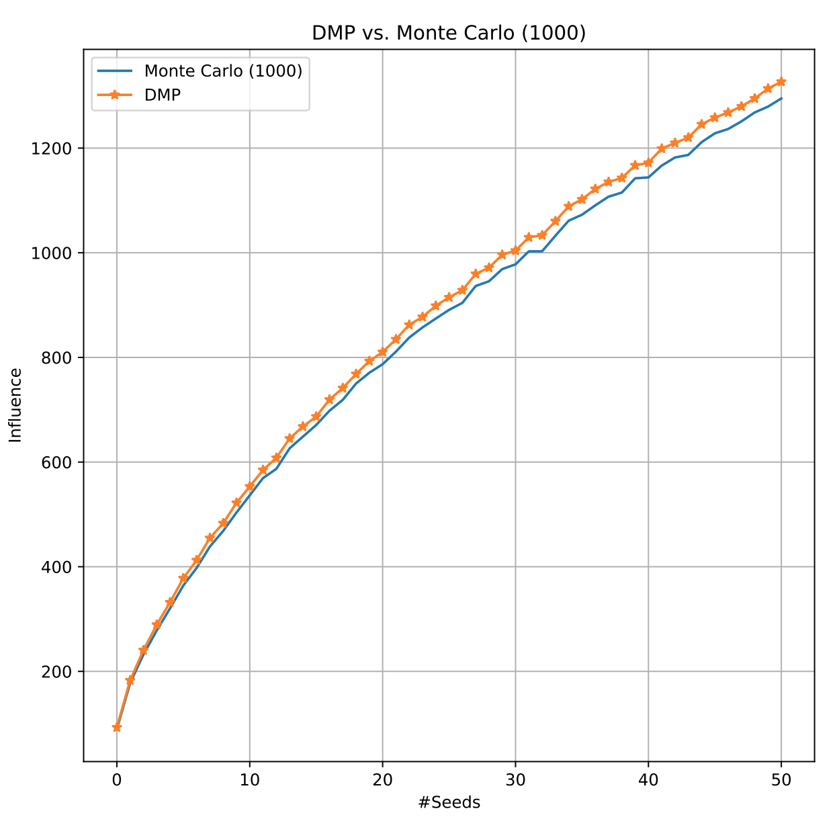
2. DMP for SIR (IC)
DMP vs Monte Carlo (1000)
DMP > MC (always)
Upper bound.

Slide 6
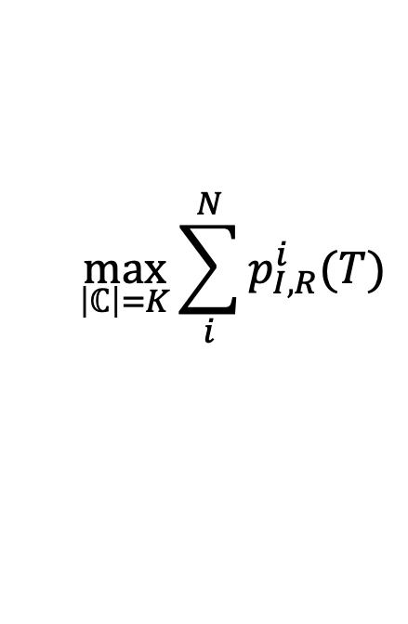
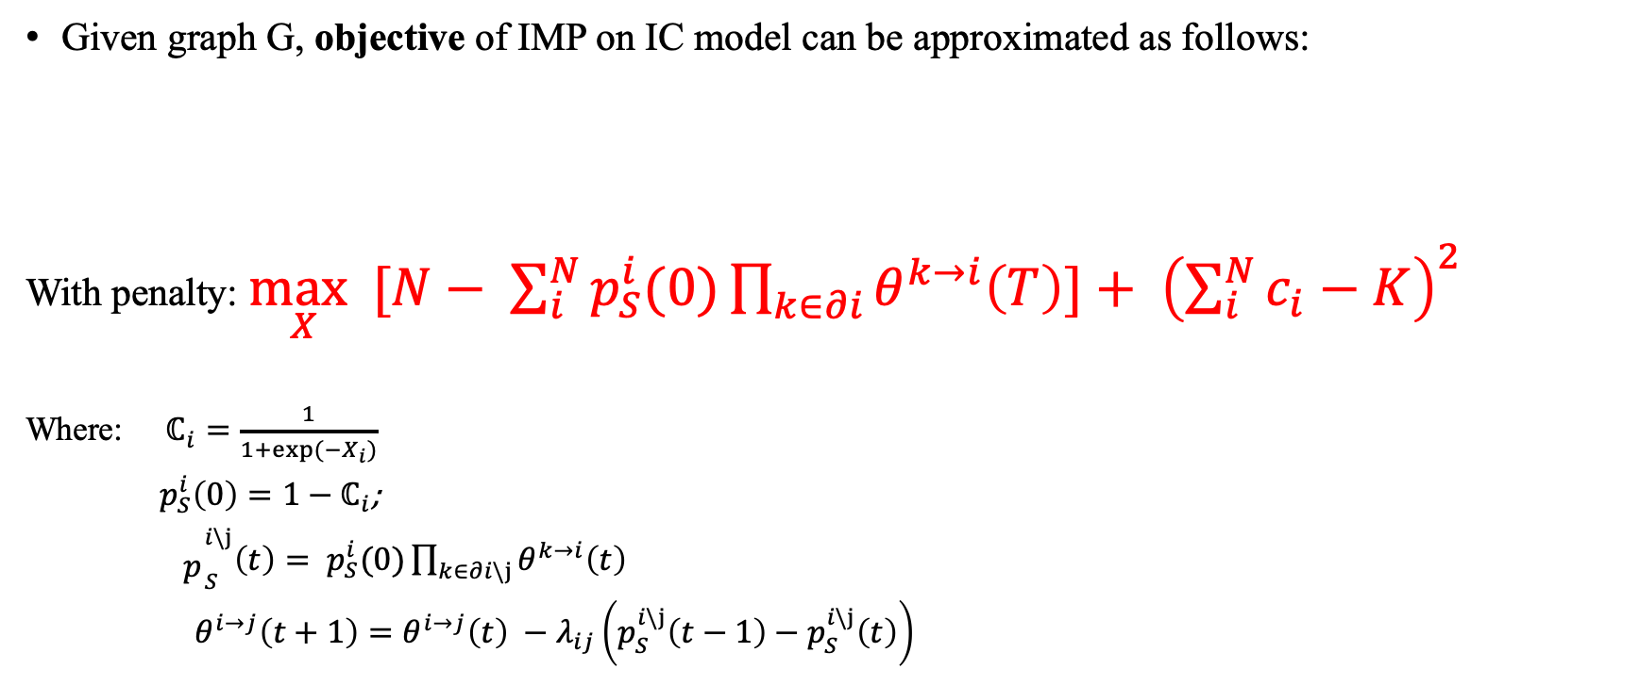
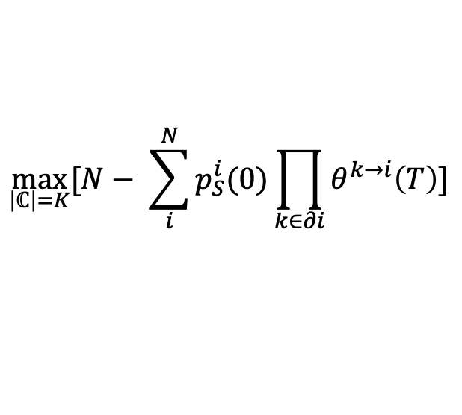
3. IMP as a Continuous Optimization Problem
Given graph G, objective of IMP on IC model can be approximated as follows:
With penalty: $\max_{X}{[N− \sum_{i}^{N}{p_{S}^{i}(0)\prod_{k∈∂i}{θ^{k→i}\left(T\right)}}]}+ {\left(\sum_{i}^{N}{c_{i}}−K\right)}^{2}$
Where: $ℂ_{i}=\frac{1}{1+exp⁡(−X_{i})}$
$p_{S}^{i}\left(0\right)=1−ℂ_{i}$;
${\begin{aligned} \\ p\end{aligned}}_{S}^{i\backslash j}\left(t\right)= p_{S}^{i}(0)\prod_{k∈∂i\backslash j}{θ^{k→i}\left(t\right)}$
$θ^{i→j}\left(t+1\right)=θ^{i→j}\left(t\right) −λ_{ij}\left(p_{S}^{i\backslash j}\left(t−1\right)−p_{S}^{i\backslash j}\left(t\right)\right)$
$$\max_{\left|ℂ\right|=K}{\sum_{i}^{N}{p_{I,R}^{i}(T)}}$$
$$\max_{\left|ℂ\right|=K}{[N− \sum_{i}^{N}{p_{S}^{i}(0)\prod_{k∈∂i}{θ^{k→i}\left(T\right)}}]}$$
Optimize using gradient descent

Slide 7
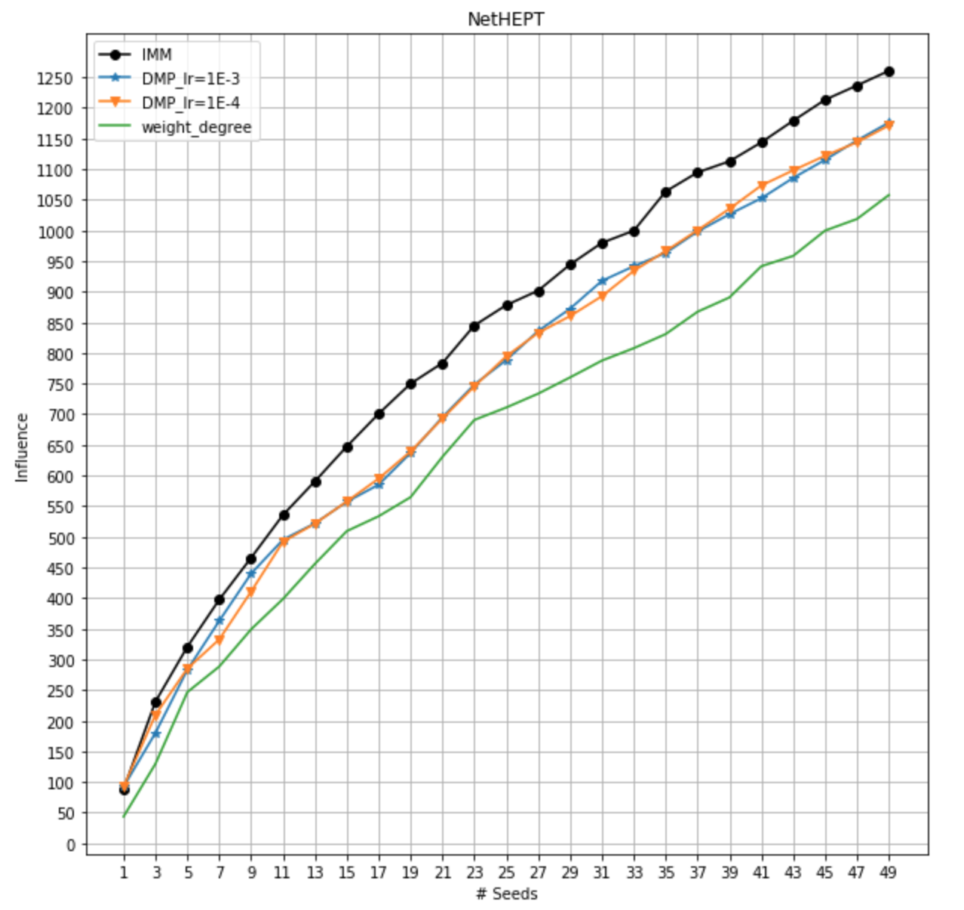
4. Experiments (vs IMM)
Algorithms:
IMM : SOTA algo. for IMP (2015).
Weight degree: naïve heuristic.
DMP Details:
Initial X=0 (i.e. C=0.5)
Update less than 10 times
Choose the K nodes with top-k
value of X as the final output.
Notes:
1. 子图初始化， 与IMM的借鉴
2. 调节 Learning Rate，看看效果是不是更加好一点。随着

Slide 8
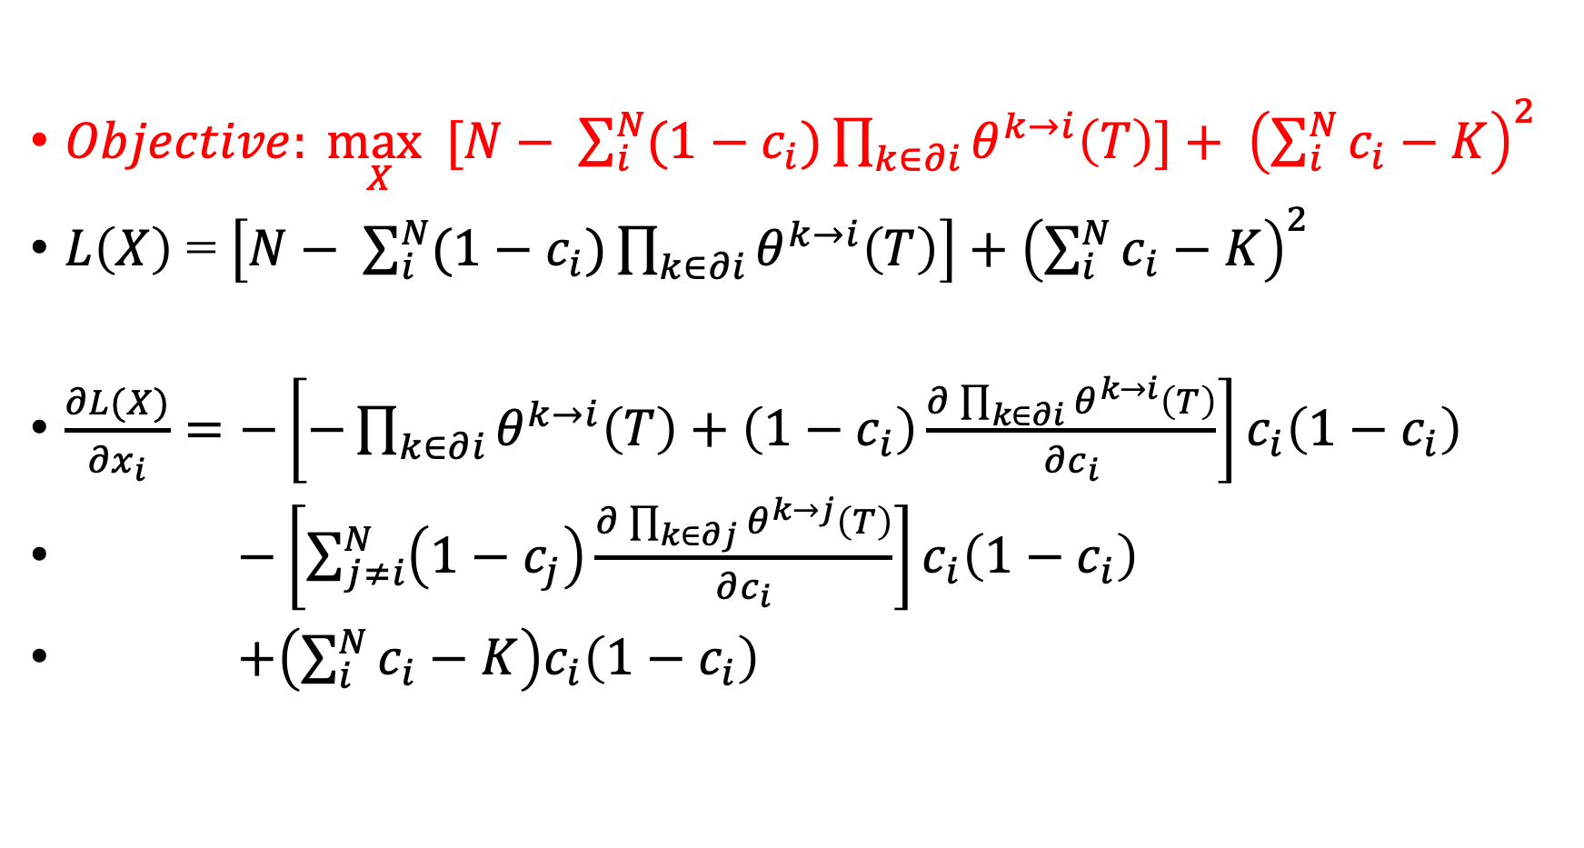
5. Analytic Results: How gradient works?
$Objective: \max_{X}{[N− \sum_{i}^{N}{(1−c_{i})\prod_{k∈∂i}{θ^{k→i}\left(T\right)}}]}+ {\left(\sum_{i}^{N}{c_{i}}−K\right)}^{2}$
$L\left(X\right)$ = $\left[N− \sum_{i}^{N}{(1−c_{i})\prod_{k∈∂i}{θ^{k→i}\left(T\right)}}\right]+{\left(\sum_{i}^{N}{c_{i}}−K\right)}^{2}$
$\frac{∂L(X)}{{∂x}_{i}}=−\left[−\prod_{k∈∂i}{θ^{k→i}\left(T\right)}+\left(1−c_{i}\right)\frac{∂\prod_{k∈∂i}{θ^{k→i}\left(T\right)}}{{∂c}_{i}}\right]c_{i}\left(1−c_{i}\right)$
$−\left[\sum_{j≠i}^{N}{\left(1−c_{j}\right)\frac{∂\prod_{k∈∂j}{θ^{k→j}\left(T\right)}}{{∂c}_{i}}}\right]c_{i}\left(1−c_{i}\right)$
$+\left(\sum_{i}^{N}{c_{i}}−K\right)c_{i}\left(1−c_{i}\right)$

Slide 9
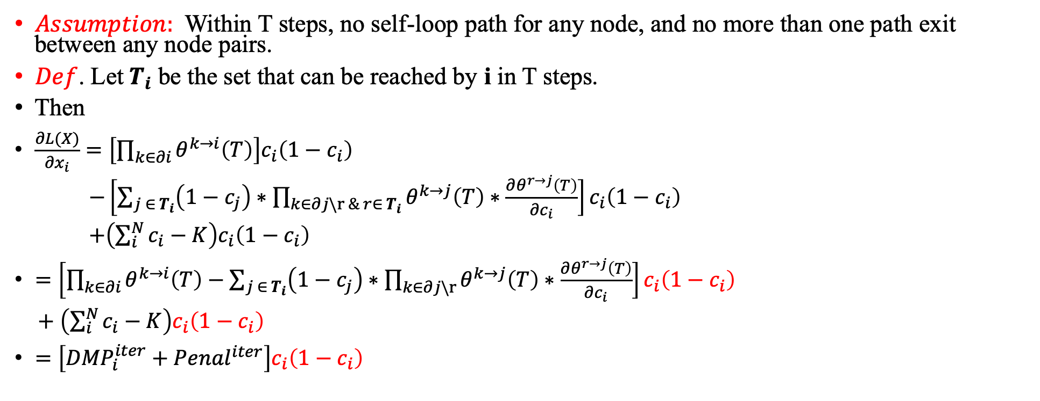
5. Analytic Results: How gradient works?
$Assumption:$ Within T steps, no self-loop path for any node, and no more than one path exit between any node pairs.
$Def$. Let$T_{i}$ be the set that can be reached by i in T steps.
Then
$\frac{∂L(X)}{{∂x}_{i}}=\left[\prod_{k∈∂i}{θ^{k→i}\left(T\right)}\right]c_{i}\left(1−c_{i}\right)$
$−\left[\sum_{j ∈{ T}_{i}}{\left(1−c_{j}\right)∗\prod_{k∈∂j\backslash r \& r∈{ T}_{i}}{θ^{k→j}\left(T\right)}∗\frac{∂θ^{r→j}\left(T\right)}{{∂c}_{i}}}\right]c_{i}\left(1−c_{i}\right)$
$+\left(\sum_{i}^{N}{c_{i}}−K\right)c_{i}\left(1−c_{i}\right)$
$=\left[\prod_{k∈∂i}{θ^{k→i}\left(T\right)−\sum_{j ∈{ T}_{i}}{\left(1−c_{j}\right)∗\prod_{k∈∂j\backslash r}{θ^{k→j}\left(T\right)}∗\frac{∂θ^{r→j}\left(T\right)}{{∂c}_{i}}}}\right]c_{i}\left(1−c_{i}\right)$
$+ \left(\sum_{i}^{N}{c_{i}}−K\right)c_{i}\left(1−c_{i}\right)$
$=\left[{DMP}_{i}^{iter}+{Penal}^{iter}\right]c_{i}\left(1−c_{i}\right)$

Slide 10
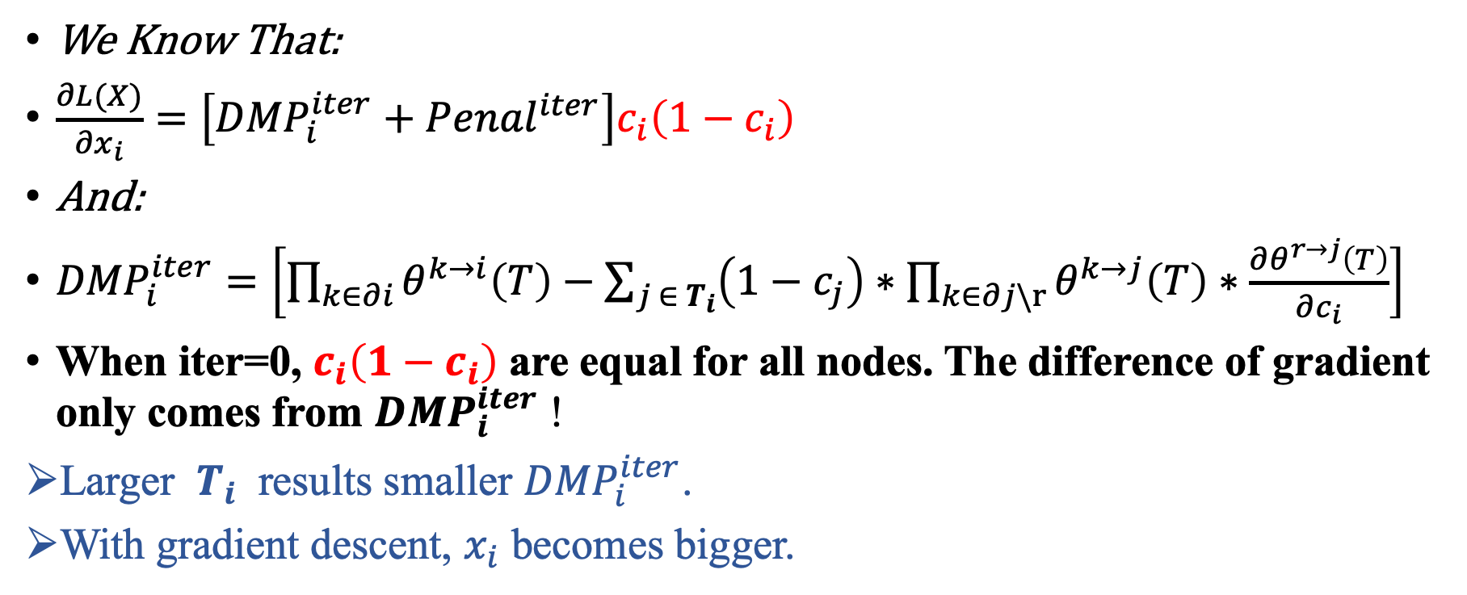
5. Analytic Results: How gradient works?
We Know That:
$\frac{∂L(X)}{{∂x}_{i}}=\left[{DMP}_{i}^{iter}+{Penal}^{iter}\right]c_{i}\left(1−c_{i}\right)$
And:
${DMP}_{i}^{iter}=\left[\prod_{k∈∂i}{θ^{k→i}\left(T\right)−\sum_{j ∈{ T}_{i}}{\left(1−c_{j}\right)∗\prod_{k∈∂j\backslash r}{θ^{k→j}\left(T\right)}∗\frac{∂θ^{r→j}\left(T\right)}{{∂c}_{i}}}}\right]$
When iter=0, $c_{i}\left(1−c_{i}\right)$ are equal for all nodes. The difference of gradient only comes from ${DMP}_{i}^{iter}$ !
Larger ${ T}_{i}$ results smaller ${DMP}_{i}^{iter}$.
With gradient descent, $x_{i}$ becomes bigger.

Slide 11
5. Analytic Results: How gradient works?
Now we can answer why better than Weight degree. （ qualitatively）
Gradient based optimization considers T-hop, while weight degree only 1-hop ！

Slide 12
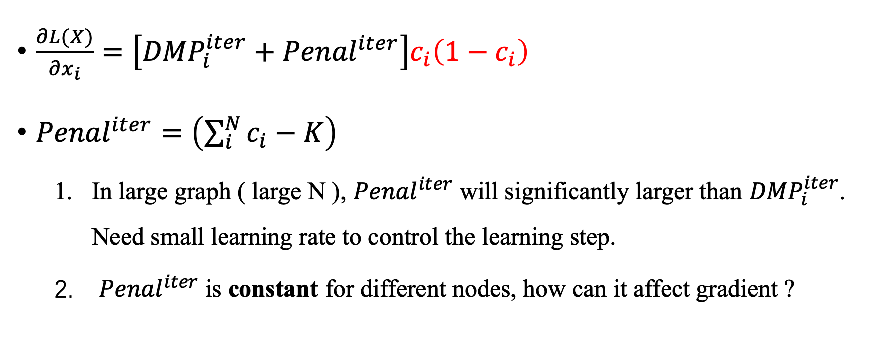
5. Analytic Results: How penalty works ？
$\frac{∂L(X)}{{∂x}_{i}}=\left[{DMP}_{i}^{iter}+{Penal}^{iter}\right]c_{i}\left(1−c_{i}\right)$
${Penal}^{iter}=\left(\sum_{i}^{N}{c_{i}}−K\right)$
In large graph ( large N ), ${Penal}^{iter}$ will significantly larger than ${DMP}_{i}^{iter}$. Need small learning rate to control the learning step.
${Penal}^{iter}$ is constant for different nodes, how can it affect gradient ?

Slide 13
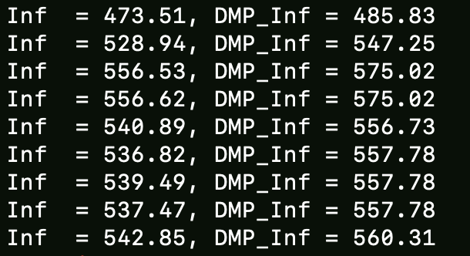
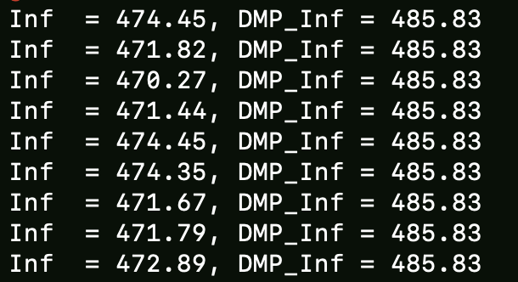
5. Analytic Results: How penalty works ？
W/ & W/O Penalty term:
Without penalty (right), gradient only depends on topology, which means the order of nodes only
depends on topology.
With penalty (left), the order of nodes will change (which means their gradient’s relative size will change)

Slide 14
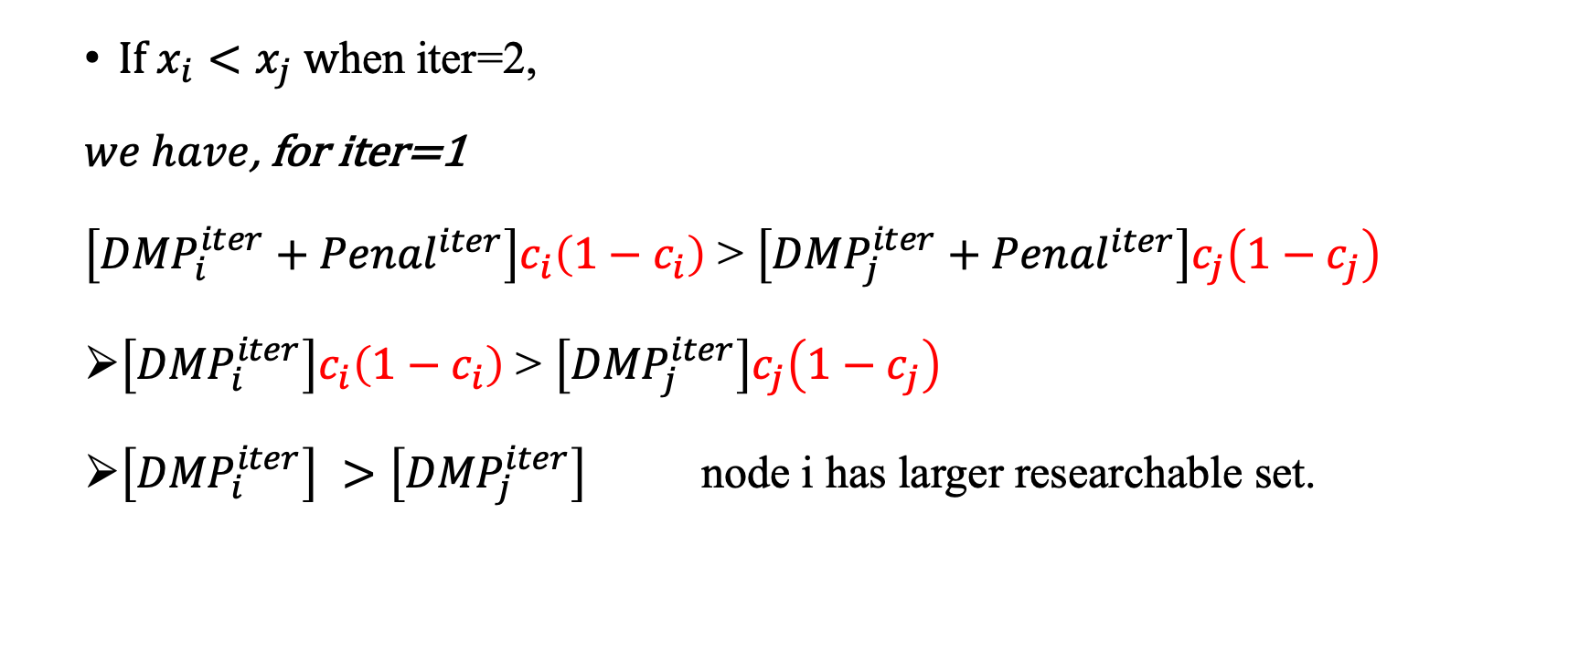
5. Analytic Results: How penalty works ？
$If x_{i}<x_{j} w$hen iter=2,
$we have$, for iter=1
$\left[{DMP}_{i}^{iter}+{Penal}^{iter}\right]c_{i}\left(1−c_{i}\right)$ > $\left[{DMP}_{j}^{iter}+{Penal}^{iter}\right]c_{j}\left(1−c_{j}\right)$
$\left[{DMP}_{i}^{iter}\right]c_{i}\left(1−c_{i}\right)$ > $\left[{DMP}_{j}^{iter}\right]c_{j}\left(1−c_{j}\right)$
$\left[{DMP}_{i}^{iter}\right] >\left[{DMP}_{j}^{iter}\right]$ node i has larger researchable set.

Slide 15
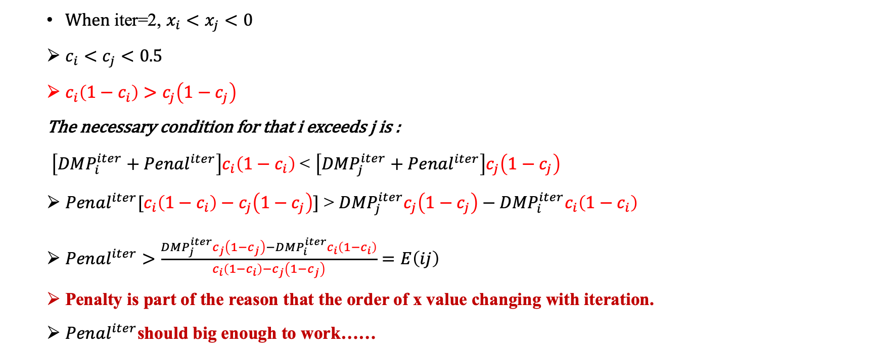
5. Analytic Results: How penalty works ？
When iter=2, $x_{i}<x_{j}<0$
$c_{i}<c_{j}<0.5$
$c_{i}\left(1−c_{i}\right)>c_{j}\left(1−c_{j}\right)$
The necessary condition for that i exceeds j is :
$\left[{DMP}_{i}^{iter}+{Penal}^{iter}\right]c_{i}\left(1−c_{i}\right)$ < $\left[{DMP}_{j}^{iter}+{Penal}^{iter}\right]c_{j}\left(1−c_{j}\right)$
${Penal}^{iter}[c_{i}\left(1−c_{i}\right)−c_{j}\left(1−c_{j}\right)]$ > ${DMP}_{j}^{iter}c_{j}\left(1−c_{j}\right)−{DMP}_{i}^{iter}c_{i}\left(1−c_{i}\right)$
${Penal}^{iter}>\frac{{DMP}_{j}^{iter}c_{j}\left(1−c_{j}\right)−{DMP}_{i}^{iter}c_{i}\left(1−c_{i}\right)}{c_{i}\left(1−c_{i}\right)−c_{j}\left(1−c_{j}\right)}=E\left(ij\right)$
Penalty is part of the reason that the order of x value changing with iteration.
${Penal}^{iter}$should big enough to work……

Slide 16
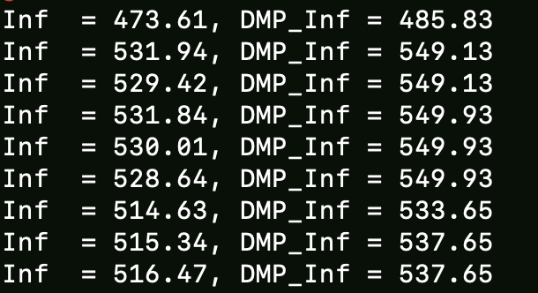
5. Analytic Results: How penalty works ？
With original penalty & with constant penalty (1E+4)
Not all the shift be good.
Why always penalty works ?

Slide 17
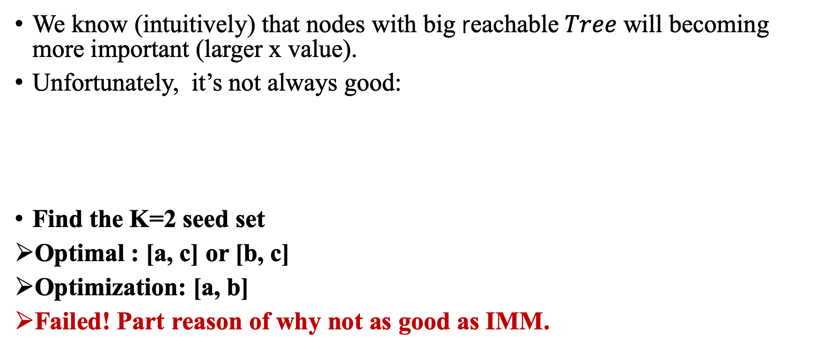
5. Analytic Results: Bad-case study
We know (intuitively) that nodes with big reachable$Tree$ will becoming more important (larger x value).
Unfortunately, it’s not always good:
Find the K=2 seed set
Optimal : [a, c] or [b, c]
Optimization: [a, b]
Failed! Part reason of why not as good as IMM.
a
b
c
Notes:
在一棵树上做实验～～～

Slide 18
Summary
Gradient based optimization prefers nodes with big reachable tree.
Penalty changes the order of nodes by affecting their gradient.
Can not distinguish nodes with same reachable tree, overlapping of nodes’ influence.

